Slide 1

C# OOP
Course Introduction
SoftUni Team
Technical Trainers
Software University
https://softuni.bg/

Slide 2
Table of Contents
Course Objectives
Training and Team
Course Organization
Course Infrastructure
Evaluation Criteria

Slide 3
Have a Question?
sli.do
#fund-csharp

Slide 4

Course Objectives

Slide 5
Why OOP?
Object-oriented programming is an important paradigm
Anyone involved in software development should be familiar with OOP and OO modelling
All modern languages are either object-oriented or support classes and objects
Modern frameworks, libraries and APIs are object-oriented
OOP is a basic requirement for starting a job as developer

Slide 6
Practical Exam
2 practical problem for 6 hours:
Create a simple projects
Should correctly follow the OOP principles
You should implement functionality based on the description
Test a provided class
Automated judge system with real-time feedback
Upload a zip project to the judge system

Slide 7

Exam Demonstration

Slide 8

The Team

Slide 9
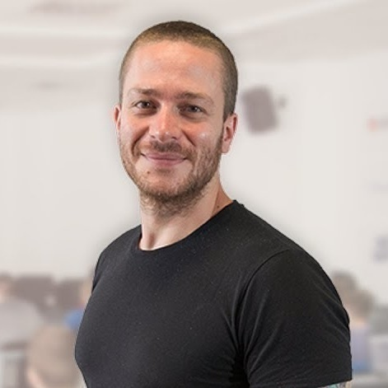
Ivaylo Kenov
Various job titles at the same time:
CTO @ SoftUni Dev Team
Technical Trainer @ SoftUni
Creator of open-source libraries for ASP.NET
MyTested.AspNetCore.Mvc
Mathematical competitions champion
Contacts:
https://github.com/ivaylokenov
https://linkedin.com/in/kenov

Slide 10
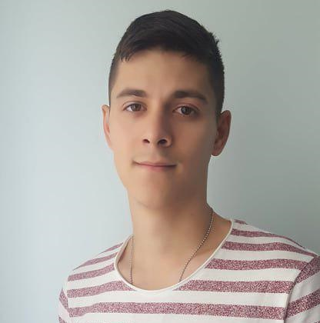
Galin Gospodinov
Technical Trainer @ Software University
Top performing student @ Software University
Interested in Web Development
Plays football in his free time

Slide 11

Course Organization

Slide 12
Course Information
7 weeks / 4 times a week
15 Credits
Time frame
25 February 2019 – 14 April 2019
Exam
14 April 2019 – 09:00
Retake
18 April 2019 – 09:00

Slide 13

Homework Assignments & Exercises
Your homework is mainly work in class
Lesson days → slides + live demos + exercises
Exercise days → only exercises
How to submit your homework?
Submitted in the judge system
Do your homework when it's due
Assignments pile up quickly

Slide 14


Scoring System for the Course
Mandatory:
Final exam – 85%
Exercises & homework – 15%
Bonuses:
Presence in class – 5% bonus
Forum activity – bonus up to 5%

Slide 15



Course Web Site, Forum and FB Group
Official web site:
Official discussion forum:
Official Facebook group:
https://softuni.bg/csharp-oop
softuni.bg/forum/categories/14/
https://www.fb.com/groups/CSharpFundamentals

Slide 16
https://softuni.bg/csharp-oop

Slide 17
SoftUni Diamond Partners

Slide 18
SoftUni Organizational Partners

Slide 19




Trainings @ Software University (SoftUni)
Software University – High-Quality Education and Employment Opportunities
softuni.bg
Software University Foundation
http://softuni.foundation/
Software University @ Facebook
facebook.com/SoftwareUniversity
Software University Forums
forum.softuni.bg

Slide 20

License
This course (slides, examples, demos, videos, homework, etc.) is licensed under the "Creative Commons Attribution-NonCommercial-ShareAlike 4.0 International" license

